Slide 1
<XML FOR HUMANITIES/>
INLS 396/795
TASP Independent Study, Spring 2023
Hosted by TFED

Slide 2
Ælfric Scriptorium Project (TASP)
The TASP team (a digital humanities initiative under the Transatlantic Forum for Education and Diplomacy) is creating a digital scriptorium to house, preserve, and publish medieval and classical texts, with a primary focus on literary, historical, and theological works.
We emphasize the visual aspects of early manuscripts by making use of Edition Visualization Technology (EVT), an open-source tool designed to create digital editions from XML-encoded texts. In the coming weeks we will discuss not only how to encode with XML, but this platform that we are using as well.

Slide 3
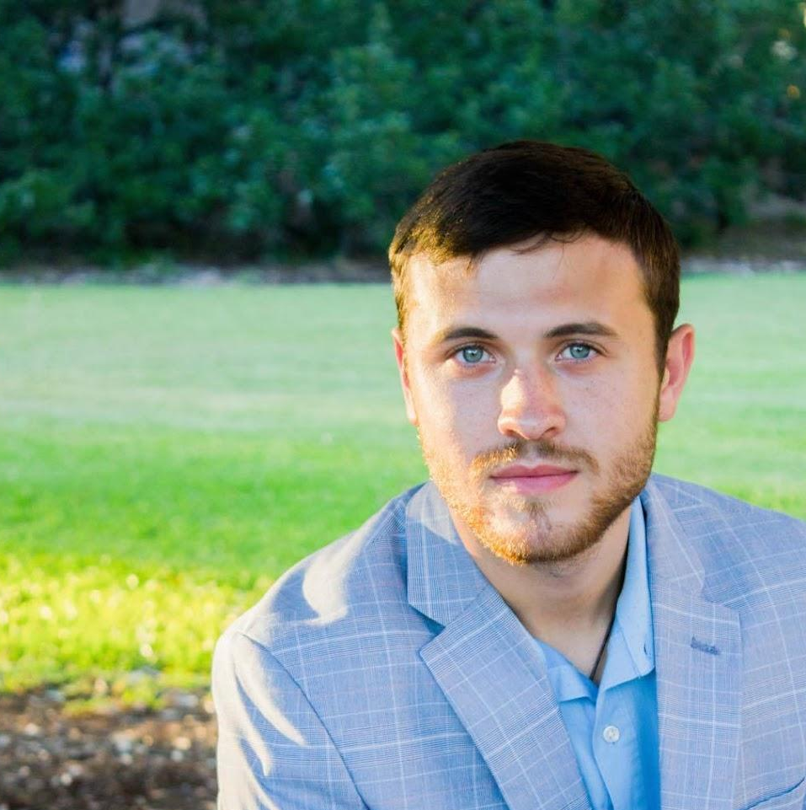
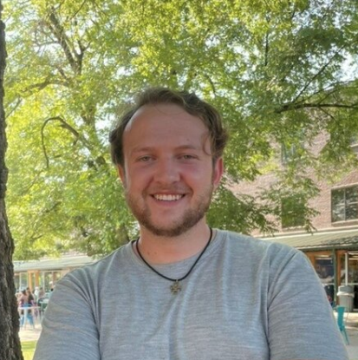
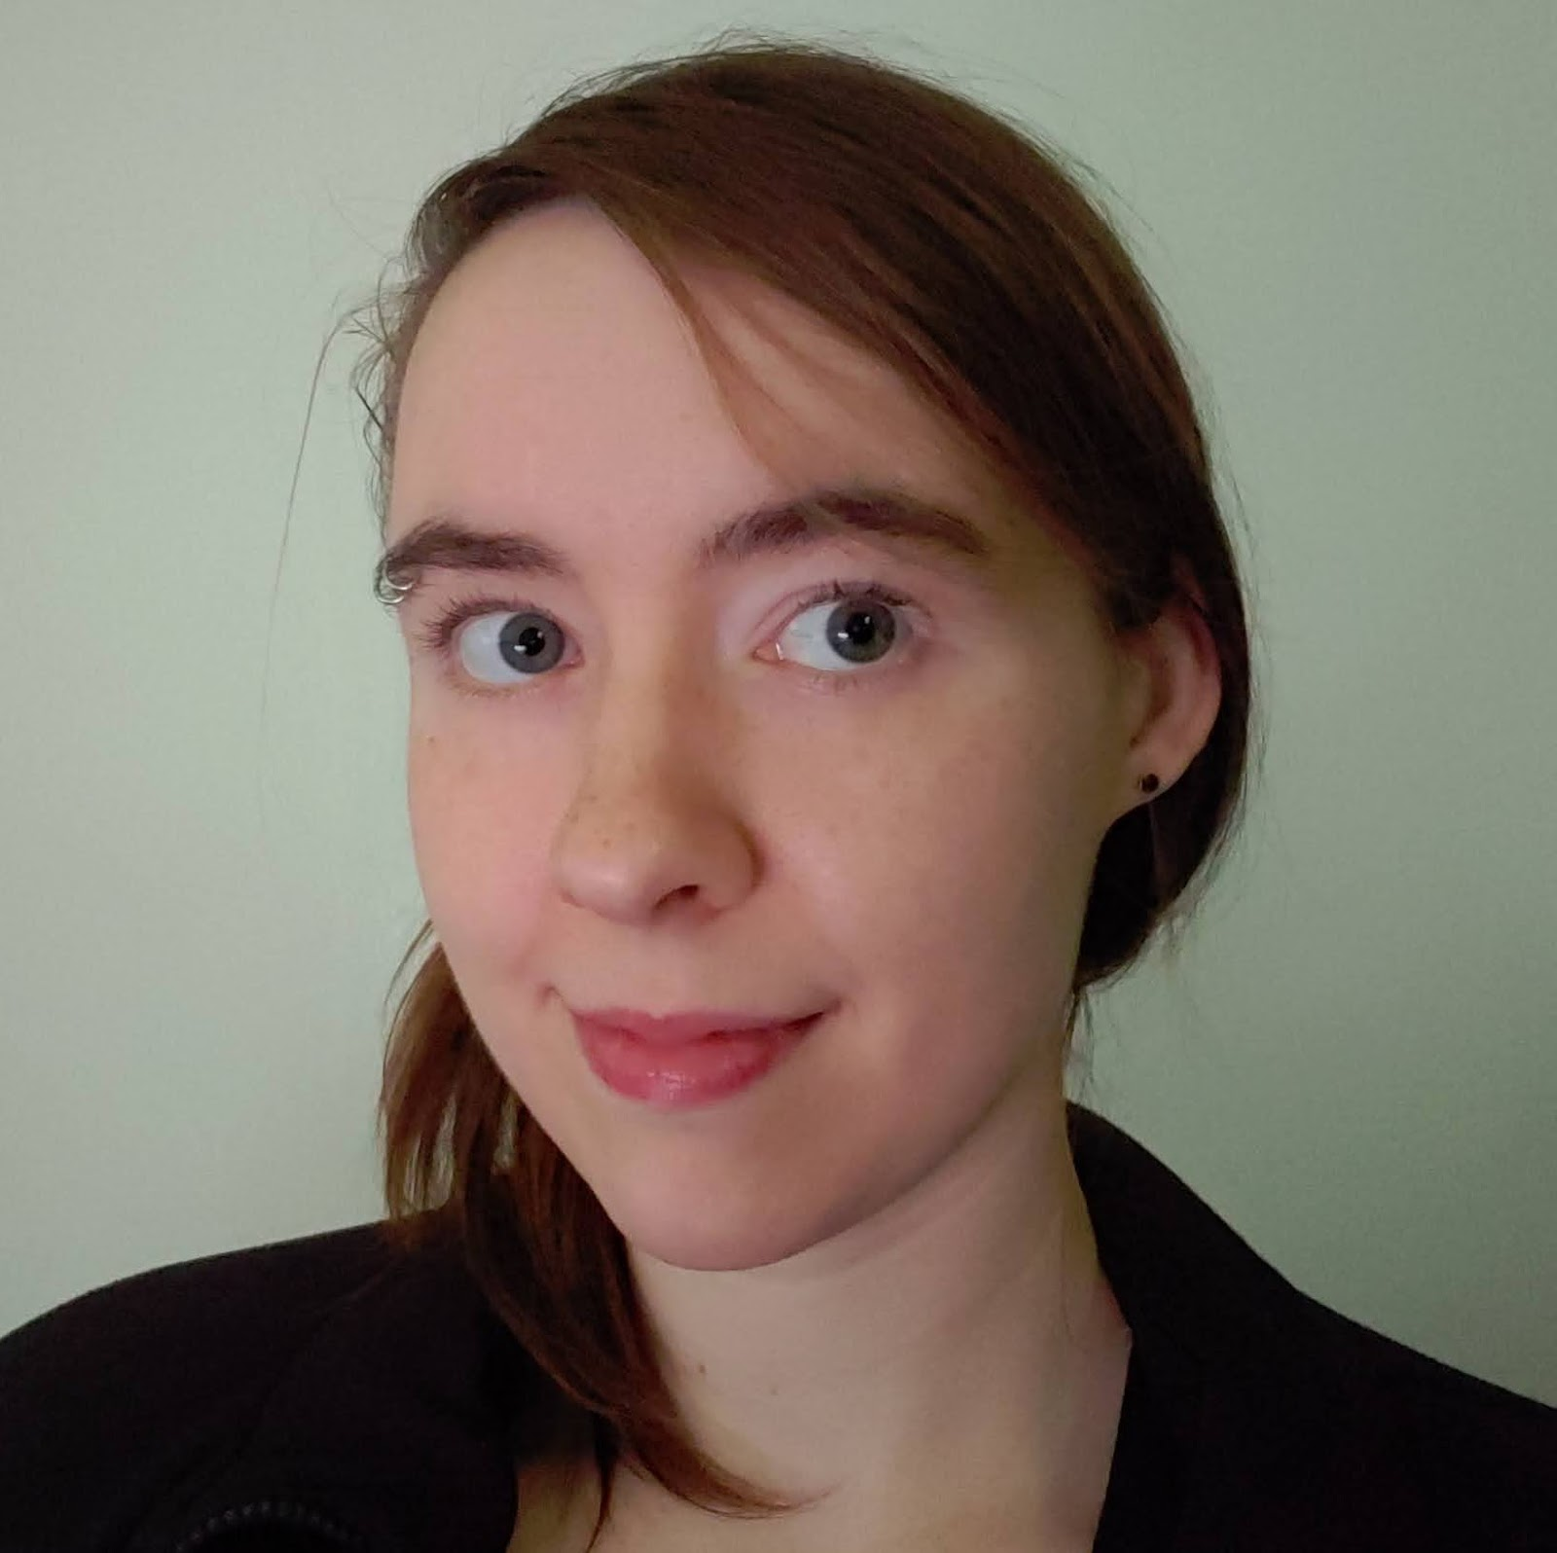
Our Team!
During the semester you will be invited to join any TASP team meetings to keep up-to-date on where we are with our broader projects, and to see the impact that the work you are doing is creating! Until then, here are brief introductions to our current team members:
Hunter Corb
Project Manager
Jake Beerli
Project Consultant
Elise Daly
TASP Project Consultant
A graduate of the UNC-SILS graduate program, Hunter specialized in rare books and manuscripts, with a particular focus in early modern book history, early printing, and descriptive bibliography.
Jake graduated from the University of North Carolina with a BA in Linguistics. With a background in IT, Jake consults on the technical side of the project.
After completing UNC's Coding Boot Camp, Elise sought roles in the IT field and began assisting the TFED Aelfric Scriptorium Project with customizations to the EVT platform and manuscript encoding. Elise is employed as a Product Operations Manager at The Princeton Review, and in her free time builds modifications for various video games.

Slide 4
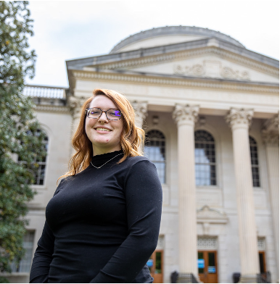
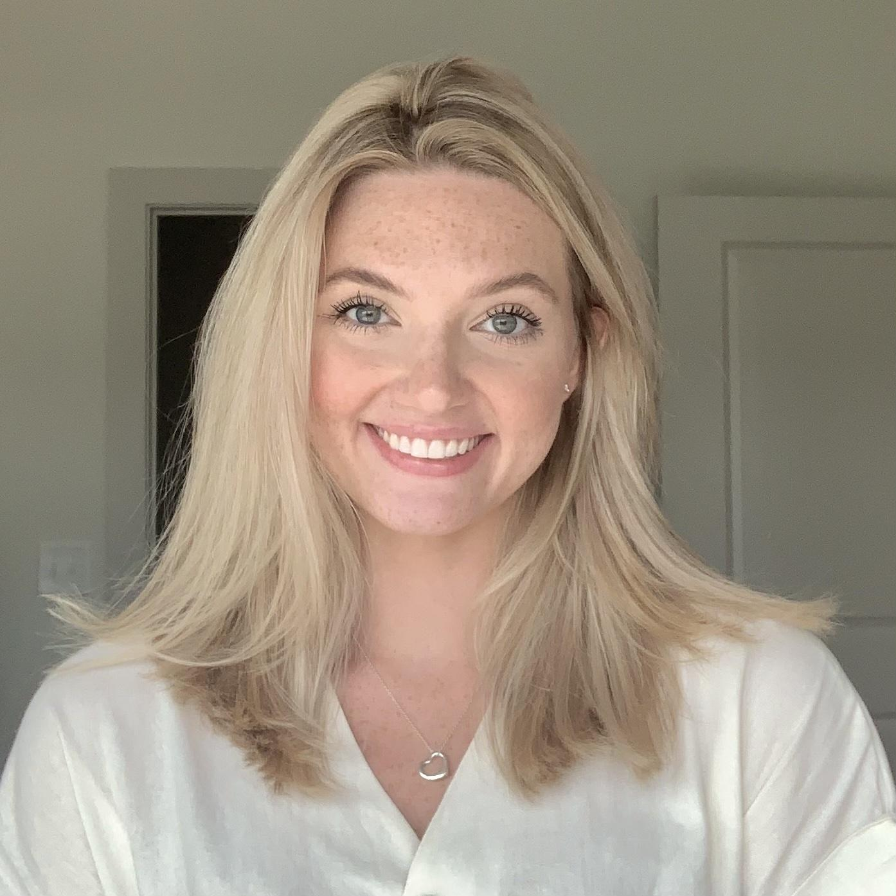
Our Team!
Sarah Bulger
XML Assistant Programmer
Eve Svoboda
XML Assistant Programmer
Aidan Canner
XML Intern
Sarah Bulger graduated from UNC-Chapel Hill with a master’s in library science with concentration in Archives and Records Management. Sarah brings to the team her interest in the maintenance and dissemination of records and information, and a deep appreciation of medieval art and history.
Eve is entering her final year of graduate study at UNC Chapel Hill, working towards a dual MA in art history and library science with a concentration in archives and records management, and a graduate certificate in digital humanities. Eve’s background in classics allows her to work mainly on the humanities side of the project, aiding with transcription and XML markup.
Aidan Canner is the newest member of the TASP team having started in the fall semester of 2022. Aidan contributes to the transcription and XML markup of manuscripts, as well as research.

Slide 5
Semester Plan
Week 4 – Introduction to XML January 30th
Video workshop on XML, and the TEI language
Getting set up with Atom
Brief readings on TEI and XML
Begin journal
Week 5 – Transcription of Medieval Texts February 6th
Workshop on nuanced transcription of medieval Latin using Alcuin’s De Ratione Animae
Begin independent research on digital humanities initiatives for blog post
Week 6 – Digital Editions and the Humanities February 13th
No meeting on Monday, University Well-being Day
Work on short blog posts for the TASP page on digital humanities research and the role of digital manuscript editions
Weeks 7 – 9 – XML Markup of Alcuin’s De Ratione Animae Feb. 20th – Mar. 6th
Encoding in XML, 25 lines per week
Notes:
We’ll meet at this zoom link: https://us05web.zoom.us/j/83726731969?pwd=cTV2bVBpUXNSbU51VWV4aCtIMWZwQT09
I will also attach this in the email, but it will exist here in these slides in case you ever need help finding it again.

Slide 6
Semester Plan
Week 10 – Spring Break March 13th
Enjoy your break!
Weeks 11 – 15 – Continuing with XML and the basics of TEI Mar. 20th – Apr. 17th
Continue encoding Alcuin’s De Ratione Animae, 50 lines p. wk.
Week 16 – Final Meeting April 24th
Go over the last lines of XML
Wrap up journal
Reflections on the semester, begin final paper if not already started
Final Deliverables Due May 1st
Reflection Paper turned into advisor
Journal entries
Completed XML lines
Notes:
We’ll meet at this zoom link: https://us05web.zoom.us/j/83726731969?pwd=cTV2bVBpUXNSbU51VWV4aCtIMWZwQT09
I will also attach this in the email, but it will exist here in these slides in case you ever need help finding it again.

Slide 7
Overview of Deliverables
During the semester we will work on completing 3 major deliverables.
One blog post related to XML, digital humanities, or any relevant texts to be posted on the TASP homepage
A reflection paper due end of day, May 1st
A completed version of Alcuin’s De Ratione Animae in XML

Slide 8
Resources!
TEI Workshop: https://drive.google.com/file/d/1y4955HU3KBjTwVMc-J3hVeBiWVxHqo8l/view?usp=share_link
Alcuin Google Drive Folder: https://drive.google.com/drive/folders/1kBWsBLr_-Qmms5hAxgVmMh0qA6u2tIQF?usp=share_link
Alcuin, De Ratione transcription: https://docs.google.com/document/d/10T5dttJF6nwMTaK2y9Kjd92hAWnZexUH/edit?usp=share_link&ouid=117325260977251348655&rtpof=true&sd=true
Alcuin manuscript at the British Library: f. 52r – 57r https://www.bl.uk/manuscripts/Viewer.aspx?ref=royal_ms_6_b_viii_fs001r
Task Journal: https://docs.google.com/document/d/1KornNcCRABHS5YqCrf5p53PoGinvyqRRRR0EbD3hkOY/edit
Notes:
If you have trouble accessing any of these resources, please feel free to email me at bulger.sarah@gmail.com

Slide 9

Setting up for XML Encoding
To begin marking up text you will need a text editor. I would recommend Atom Text Editor, but any text editor that is free and open source is fine.
Note: GitHub has recently released that they are sunsetting, no longer supporting, Atom, but for our purposes we will not need to worry about GitHub supporting our text editing.
Once you have the text editor of your choice, make sure you watch the Workshop video linked in the previous resource slide. This will set us up for next week.

Slide 10
<February 6th/>
This week please:
1) Watch the TEI Workshop Video: link in notes below
2) In the Task Journal Google Doc write a brief intro to yourself and your goals for the semester
3) Install a Text Editor Software of your choice
4) Skim the following:
https://drive.google.com/file/d/1t2HUPJKLg2dXcmUzTY1htkl5taN4AY6x/view?usp=share_link
https://tei-c.org/
Next Week:
1) We will discuss the decisions we have to make in transcribing medieval manuscripts as it pertains to creating digital editions
2) Brainstorm for blog posts
3) First look and questions about beginning markup in XML
Notes:
https://drive.google.com/file/d/1y4955HU3KBjTwVMc-J3hVeBiWVxHqo8l/view?usp=drive_link

Slide 11
<April 3rd/>
Reminder! Final meeting at end of month, April 24th
Go over the last lines of Alcuin De Ratione (due week of May 1st)
Wrap up journal and blog work (blogs due May 5th)
Reflections on the semester, begin final paper if not already started (due May 1st)
Readings: from TEI Guidelines
Chapter 3: Elements Available in All TEI Documents
Read Section 3.5
Chapter 5: Characters, Glyphs, and Writing Modes
Read Section 5.3
Chapter 11: representation of Primary Sources
Read Sections 11.1 and 11.2
Guest Speaker Today! Jake Beerli
Notes:
Chapter 3: Elements Available in All TEI Documents, Section 3.5 - Simple Editorial Changes (https://www.tei-c.org/release/doc/tei-p5-doc/en/html/CO.html)
Chapter 5: Characters, Glyphs, and Writing Modes, Section 5.3 - Annotating Characters (https://www.tei-c.org/release/doc/tei-p5-doc/en/html/WD.html#D25-30)
Chapter 11: Representation of Primary Sources, Section 11.1 - Digital Facsimiles; Section 11.2 - Combining Transcription with Facsimile (https://www.tei-c.org/release/doc/tei-p5-doc/en/html/PH.html#PHFAX)

